Slide 1


Europe, let's
cooperate!
Interregional cooperation forum
20-21 March 2024
Antwerp

Slide 2

Agenda

Slide 3
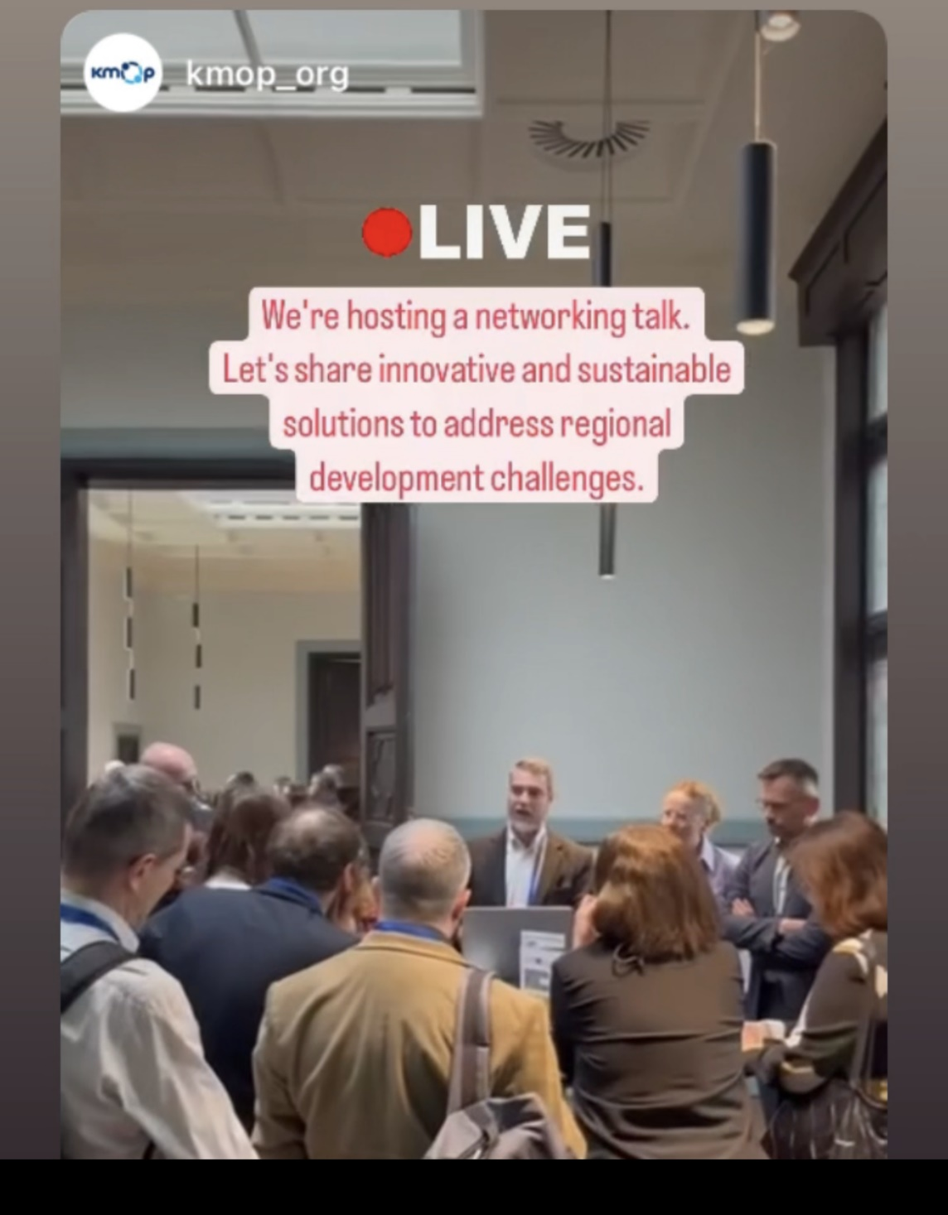
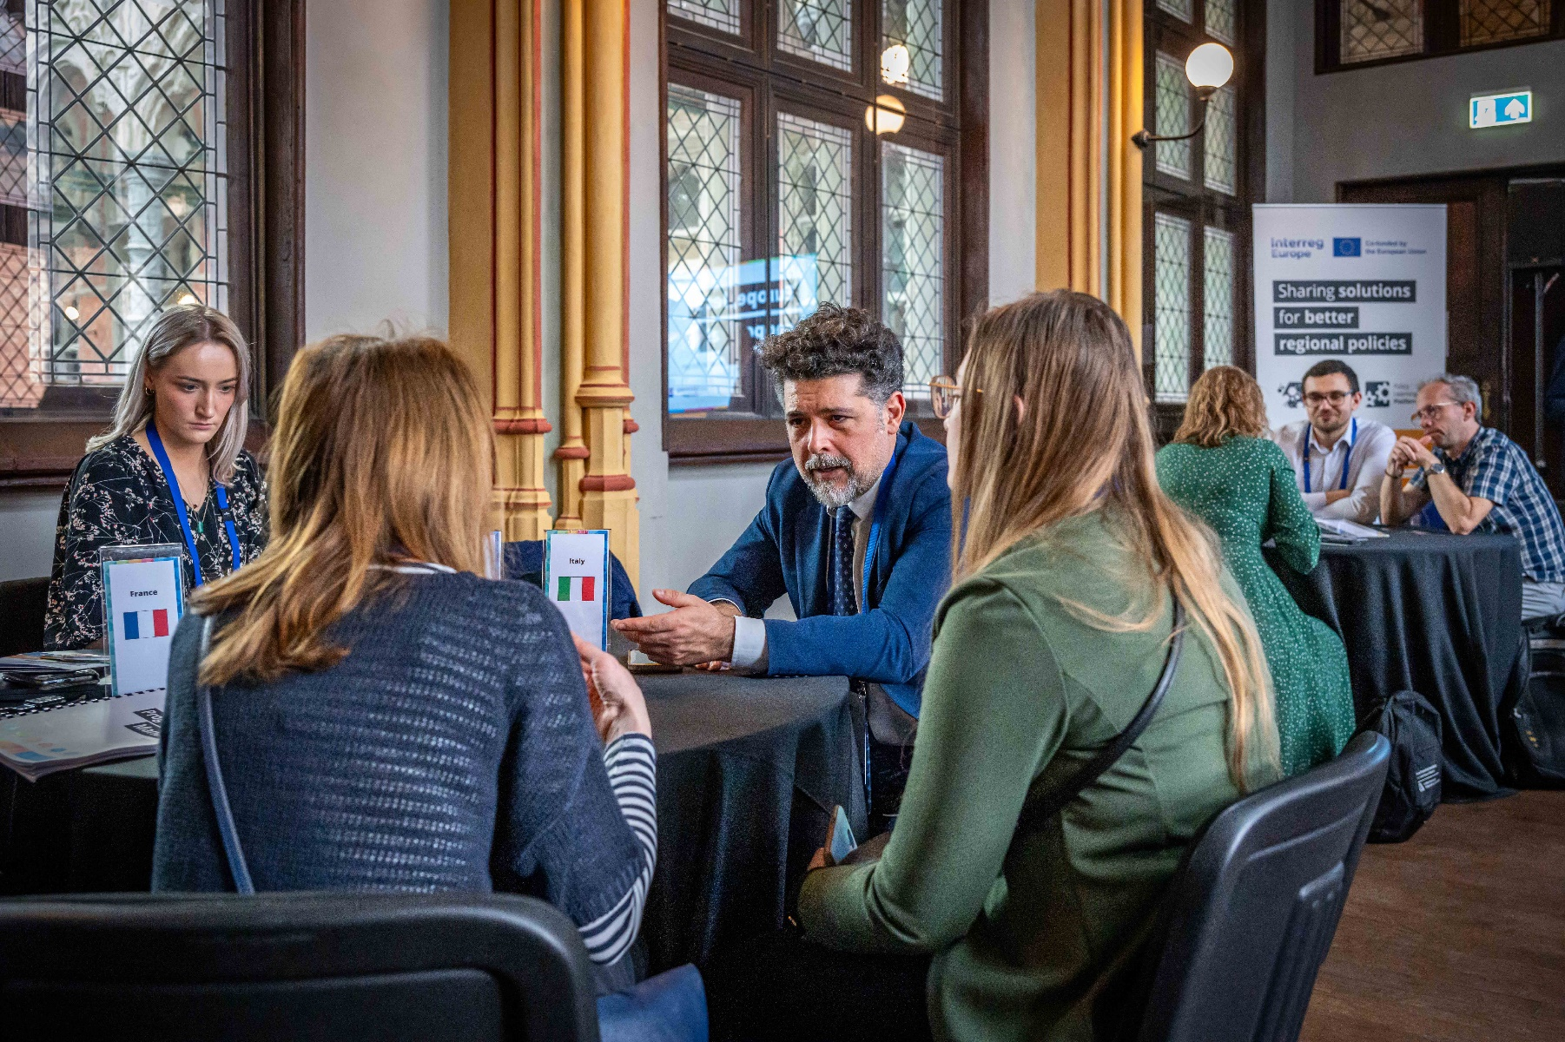
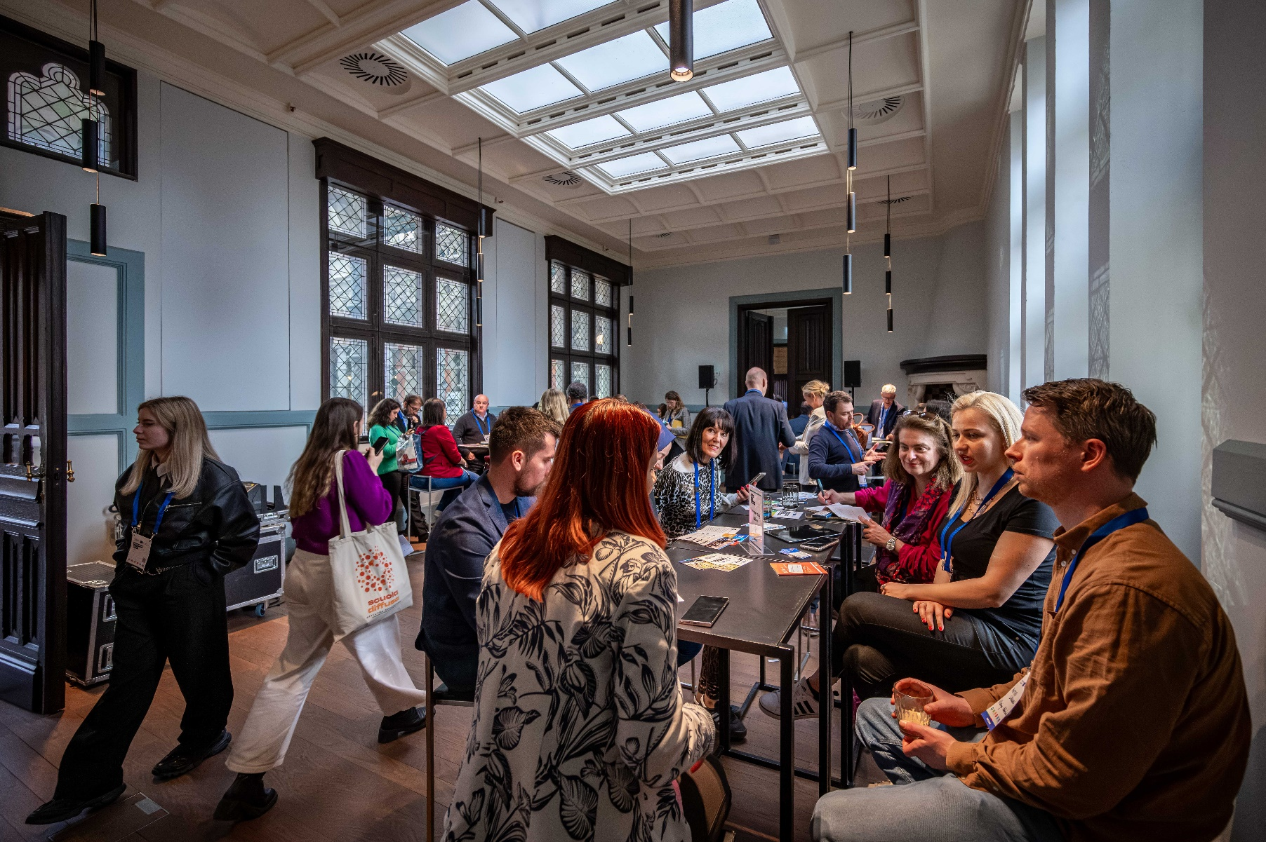
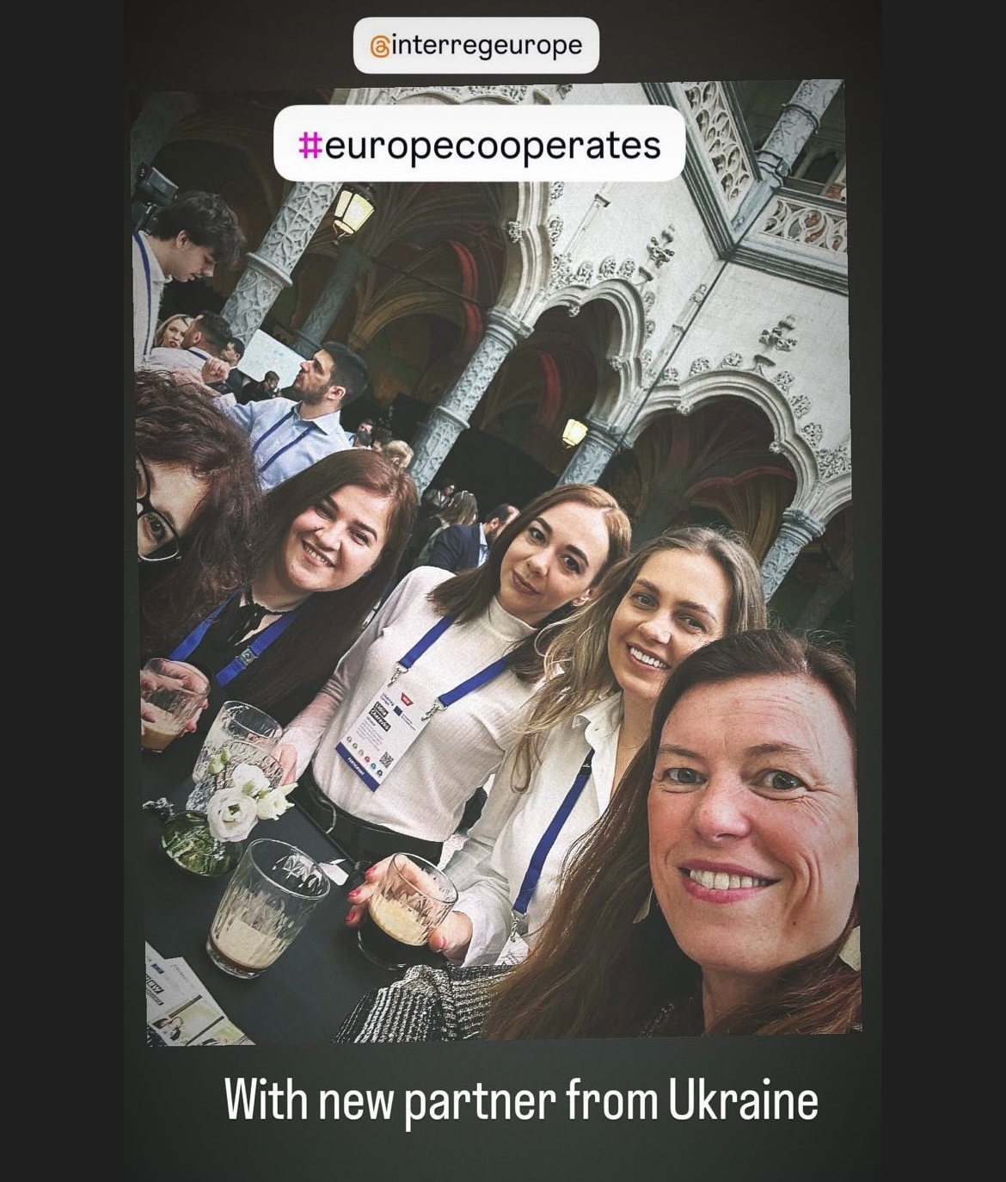
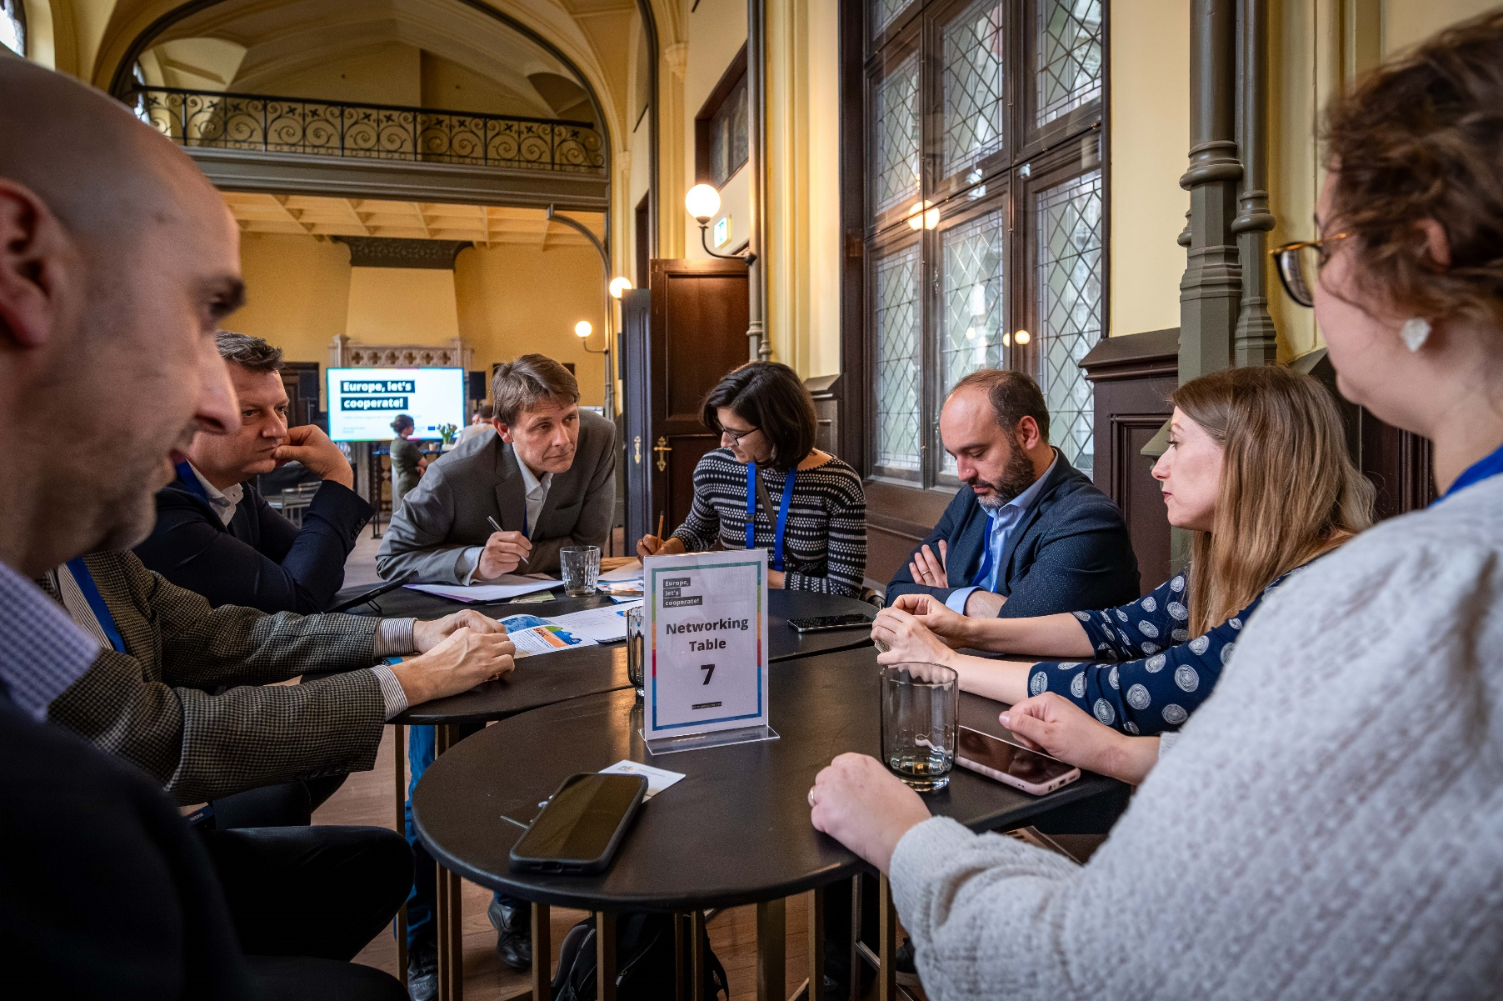
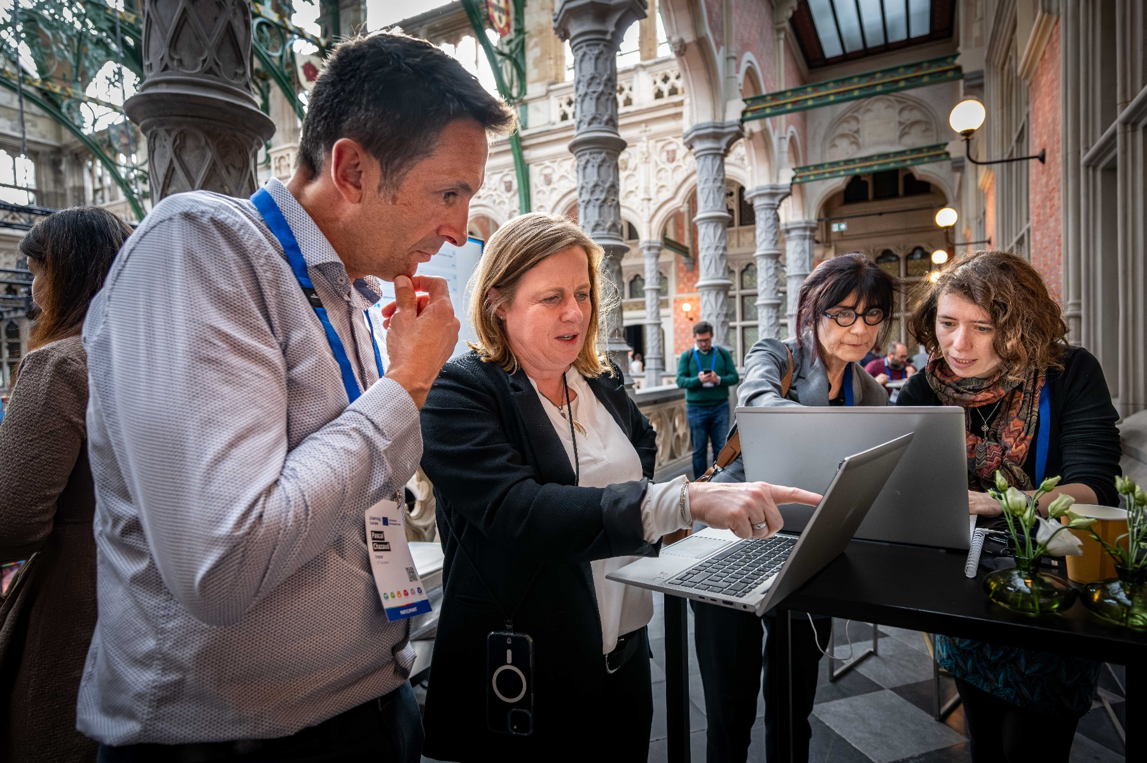
Networking

Slide 4

Opening plenary.
Policy Learning Platform.
Elena Ferrario, Interreg Europe Policy Learning Platform
Thorsten Kohlisch, Interreg Europe Policy Learning Platform
Antoine Duquennoy, Interreg Europe Policy Learning Platform

Slide 5



Policy
Learning Platform
Knowledge
Find policy solutions
People
Meet our
community
Expertise
Get policy advice
#europecooperates

Slide 6
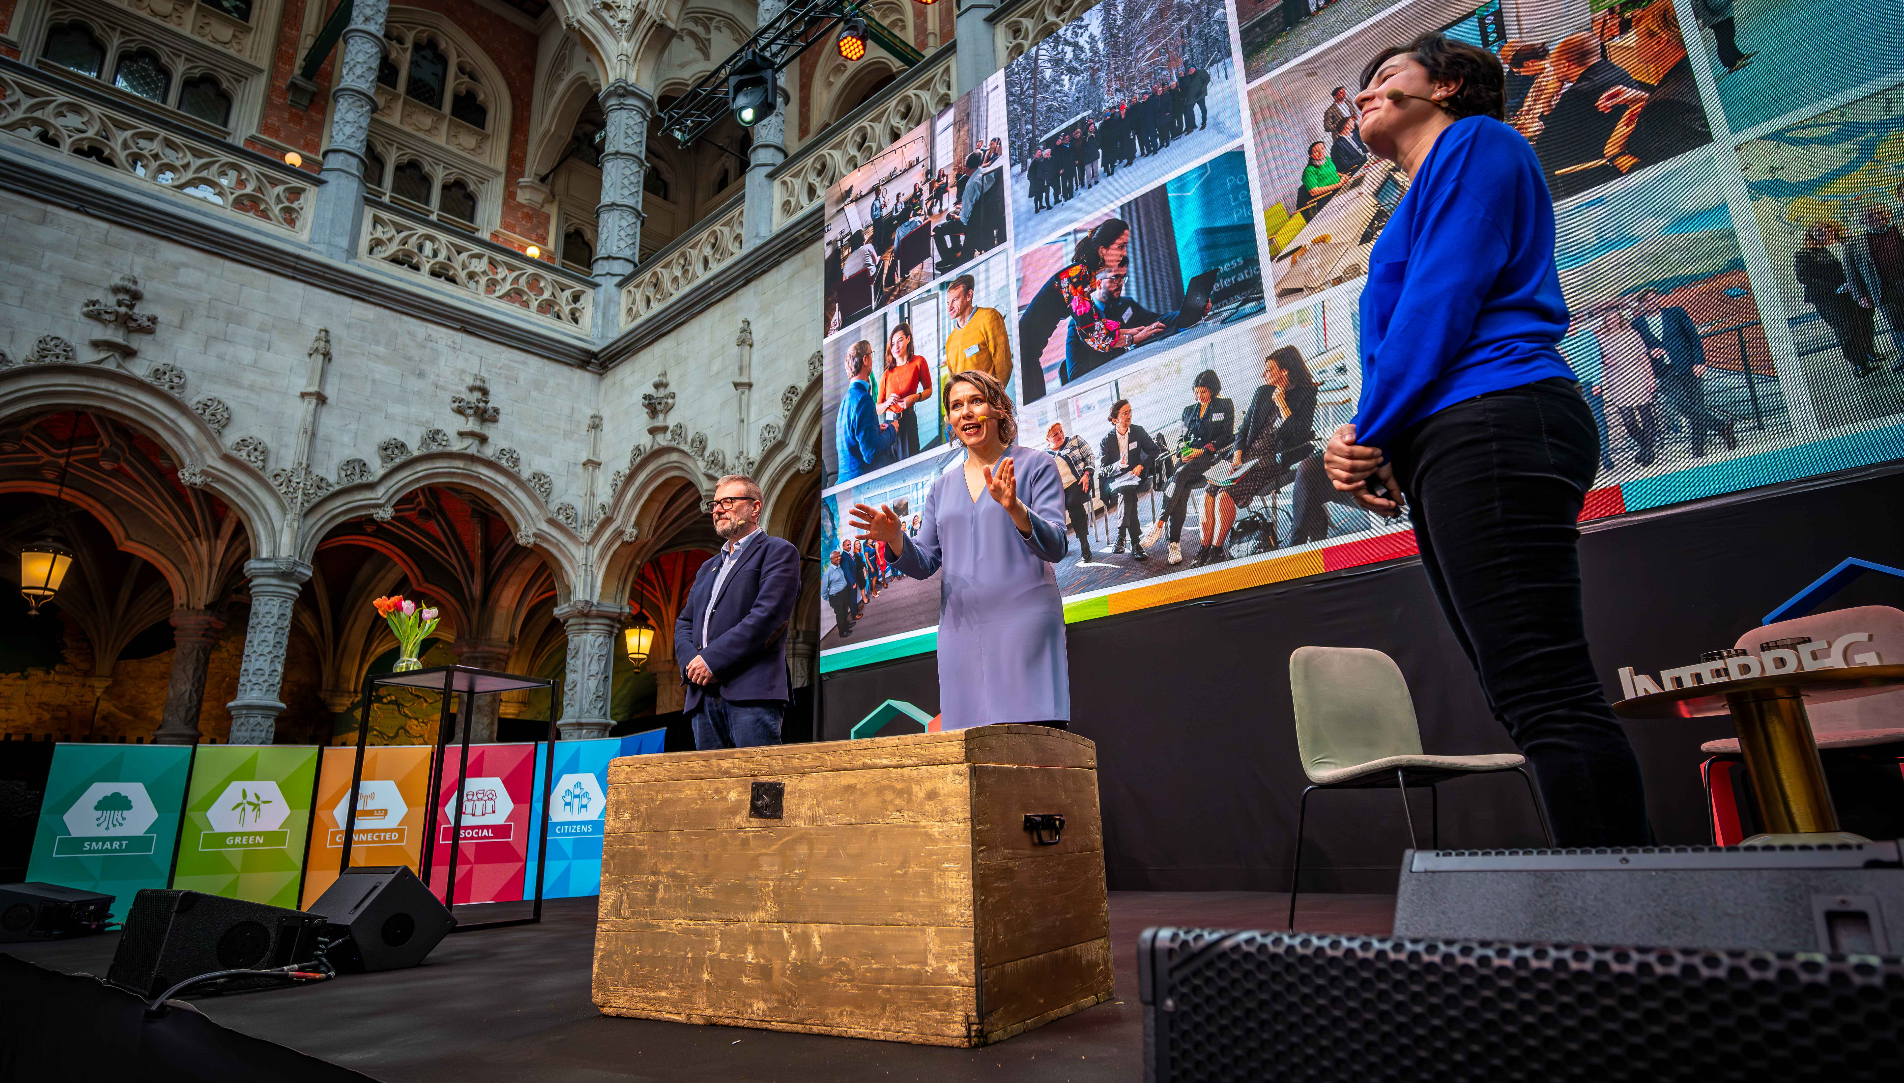
Policy Learning Platform
a treasure of resources
#europecooperates

Slide 7
3,200+
good practices
#europecooperates

Slide 8
500+
publications
#europecooperates

Slide 9
13,000+
practitioners
10,000+
organisations
#europecooperates

Slide 10
180+
policy-learning events
#europecooperates

Slide 11


73
peer reviews
44
matchmakings
#europecooperates

Slide 12
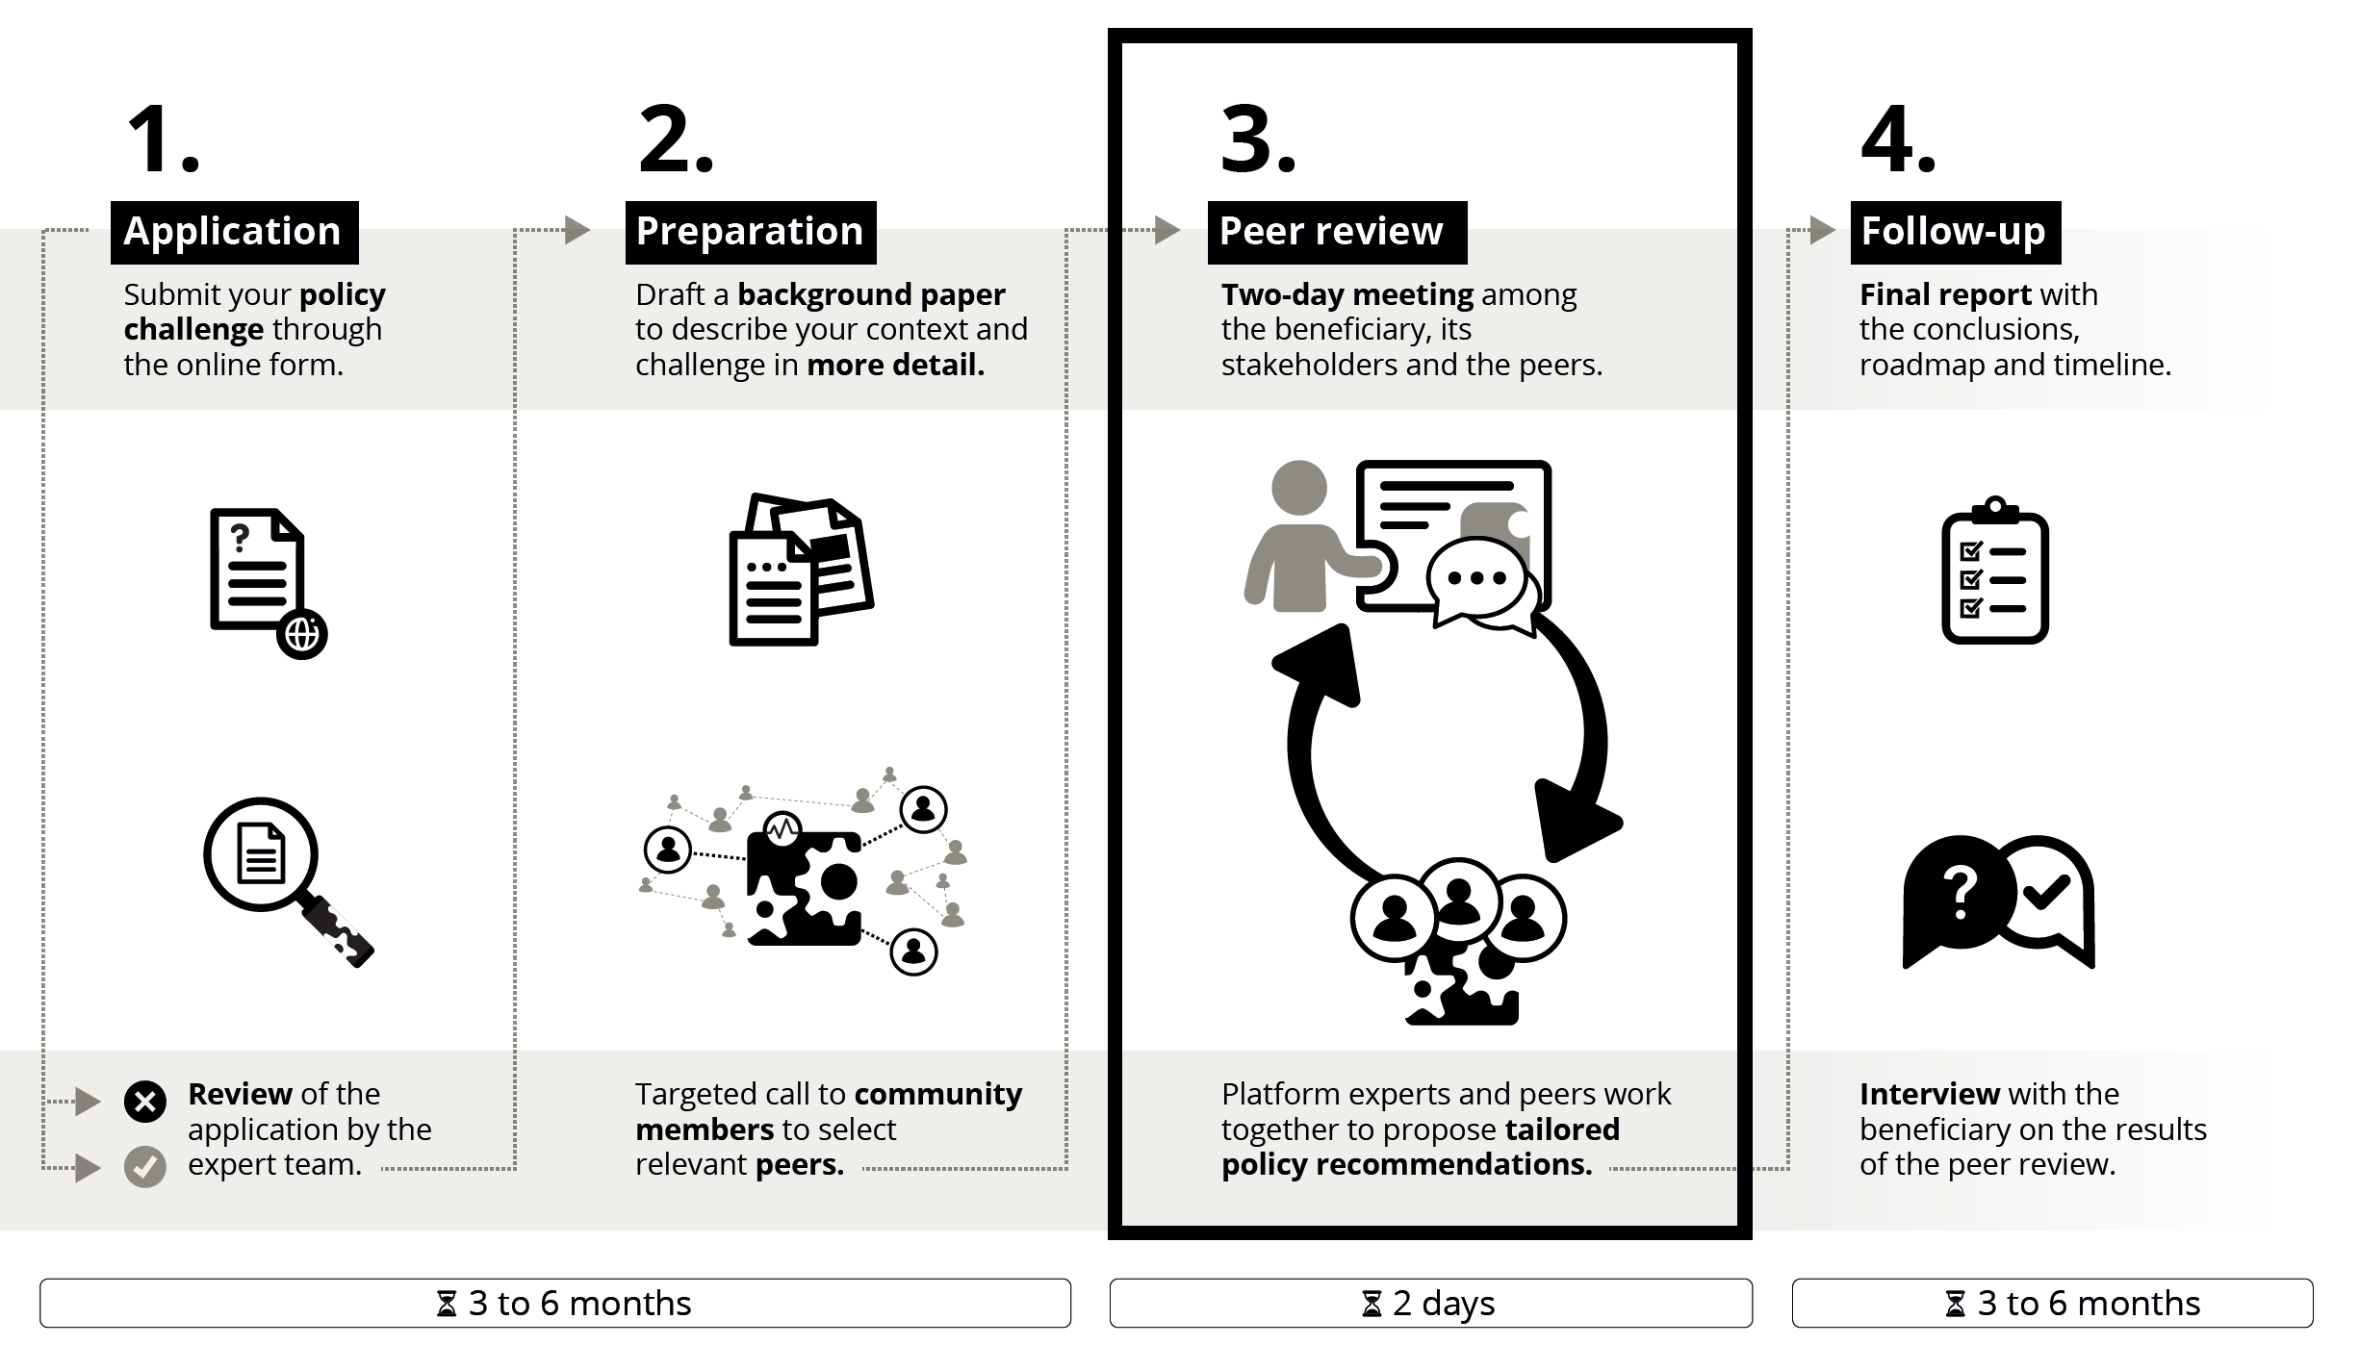

Slide 13
Opening plenary.
Policy Learning Platform.
Elena Mengotti, Friuli Venezia Giulia Autonomous Region (Italy)
Joaquin Crespo Martin, Development Agency of Aragon (Spain)

Slide 14
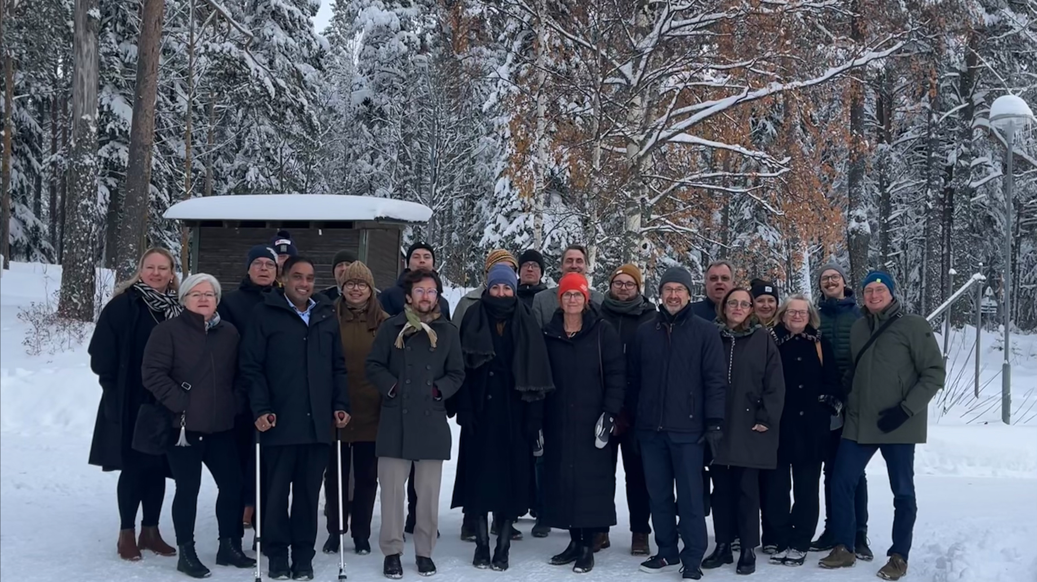

Slide 15

Policy Helpdesk
meet our experts
#europecooperates

Slide 16
Europe, let's
cooperate!
Interregional cooperation forum

